Slide 1
U.S. Copyright Law
INFO 4940/5940
Instructor: Mike Priehs
Multilateral Treaties; Fairness & Personality Theories
February 10, 2025

Slide 2


Last Week
The Subjects of Copyright
Literary Works (and Software)
Dramatic Works (and Choreography)
Music
Movies & A/V Works
Fictional Characters
Visual and Architectural Works

Slide 3
Today’s Agenda
Multilateral Treaties
Fairness Theory
Personality Theory

Slide 4
What is a multilateral treaty?
A multilateral treaty is an agreement between three or more countries. These treaties are designed to establish common standards, rules, or obligations among the participating members. They can cover a wide range of issues, including trade, environmental protection, human rights, and security.
Examples include the Paris Agreement on climate change and the United Nations Charter.

Slide 5
Multilateral Treaties
Berne Convention
Universal Copyright Convention
Rome Convention
Agreement on Trade-Related Aspects of Intellectual Property Rights (TRIPS)
WIPO Copyright Treaty
WIPO Performances and Phonograms Treaty
WIPO Treaty on Exceptions for the Visually Impaired
Notes:
List of Multilateral Treaties that had a significant impact on U.S. copyright law
More important from this list: Berne Convention & TRIPS (Agreement on Trade-Related Aspects of Intellectual Property)

Slide 6
Berne Convention
First multilateral treaty to be adopted
Began in 1858, adopted by 10 countries in 1886
Revised 7 times
Currently 179 countries are contracting parties
Notes:
Original 10 countries: Belgium, France, Germany, Haiti, Italy, Liberia, Spain, Tunisia, and the United Kingdom

Slide 7
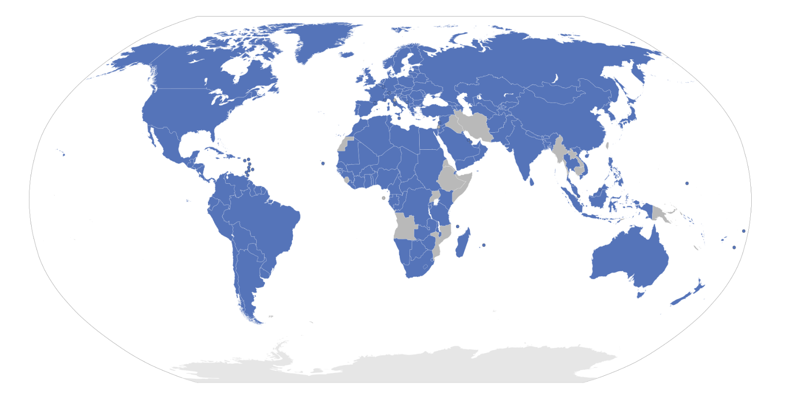
Berne Convention Parties
https://commons.wikimedia.org/wiki/File:Berne_Convention_signatories.svg
Notes:
Currently 179 countries have adopted it. (there are 195 countries in the world – according to the United Nations)

Slide 8
Berne Convention
National Treatment Principle
  Each member country must accord to protected authors the same rights it accord its own nationals
    Principle does not apply to neighboring rights
  Retaliation permissible against nationals of nonmember countries for lack of reciprocity
Notes:
3 dimensions of the current convention are important for copyright: National Treatment Principle, prohibition on formalities, and a set of obligations that were imposed on all members.
National Treatment Principle
Prior to convention: Reciprocity Principle is how it worked. Basically, one country would grant copyright protection to specific countries if the other country agreed to do the same.
Berne Convention simplified this process. If you are a party of the convention, your country MUST grant rights to citizens of other Berne Convention countries.
Neighboring Rights:
Term used in many countries to describe legal rights of performers and producers that are adjacent to copyright, but not true copyrights. These are governed by the Rome Convention, which has 96 parties. The U.S. is NOT a member of the Rome Convention.
Important point here: Member countries can retaliate against citizens of nonmember countries for lack of reciprocity, including US citizens. And they do.
Example: France imposed a levy on sales of blank tapes. Money is distributed as follows:
25% for French cultural purposes
25% paid to the composers of the musical compositions recorded on the tapes
25% goes to the performers of the songs on the tapes
25% goes to the producers of the recordings.
US composers get a share of the 2nd slice because musical compositions are governed by the Berne Convention, so France can’t discriminate. On the other hand, US performers and producers are excluded from the 3rd and 4th slice because those interests aren’t covered by Berne.

Slide 9

Example – Levy on Sales in France
Paid to producers of
the recordings (25%)
French cultural purposes (25%)
Paid to composers of
musical compositions (25%)
Paid to performers of songs (25%)

Slide 10
Berne Convention
Prohibition on Formalities
  Member countries may not impose on protected authors any administrative obligations as preconditions to the acquisition, enforcement, or continuation of copyrights
    However, they can impose such obligations on works by their own nationals
Notes:
Seems like a minor dimension to focus on, but it’s not. Some countries have disagreed with this prohibition on formalities, including the US. The US did not join the Berne Convention until 1989.
Another byproduct of this: Copyrights are EVERYWHERE because they’re just granted without any formality.
Difficult or impossible to identify who owns those copyrights.
Some people advocate for reinstatement of formalities to reduce the number of copyrighted works.
This is much different than patent law.
Patent law: must comply with a ton of administrative requirements, within a limited period of time, and convince a patent examiner that the invention is useful, novel, and nonobvious. This can also become costly.

Slide 11
Berne Convention
Consists of sets of obligations, imposed on all member countries, to establish minimum levels of copyright protection.
Notes:
Final important dimension of the Berne Convention
For example, member countries must extend copyright protection to certain kinds of works, must grant the authors of those works specific exclusive rights, must allow those rights to continue for specified
periods of time, and so forth
Berne Convention has lots of such “minimum standard” requirements but provides no effective mechanism for punishing member countries when they don’t comply. As a result, countries can join the Berne Convention for the benefits, but don’t necessarily need to comply with all the obligations. They can join and then delay or refuse to comply with the provisions that they don’t like. The United States did this between 1989 and 1994 .

Slide 12
TRIPS Agreement
Agreement on Trade-Related Aspects of Intellectual Property Rights (TRIPS)
Signed in 1994
164 Parties (all members of the World Trade Organization)

Slide 13
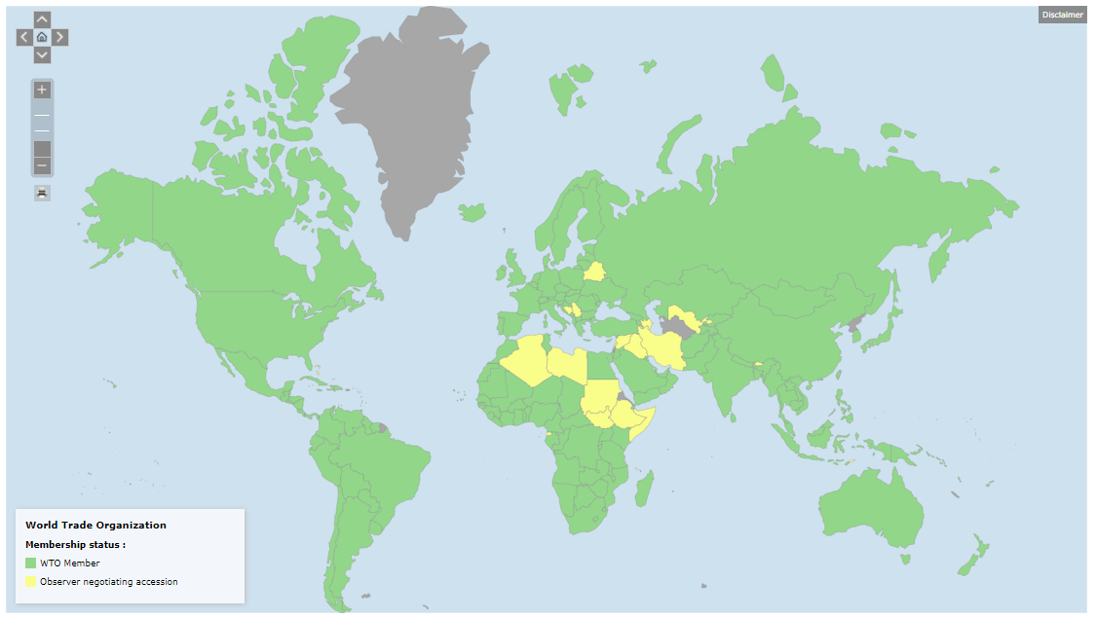
TRIPS Agreement Parties
https://www.wto.org/english/thewto_e/countries_e/org6_map_e.htm
Notes:
164 Member Countries (all members of the World Trade Organization are subject to the agreement)

Slide 14
TRIPS Agreement
Differs from Berne Convention
  Establish effective remedies when rights are violated
  Includes a mechanism to compel member countries to comply with the obligations
  Explicitly incorporates all obligations imposed by Berne except for “Moral Rights”
Notes:
In many ways, TRIPS parallels Berne.
It follows the National Treatment Principle.
Establish certain minimum levels of copyright protection:
Types of things that get copyright protection (including software)
The kinds of entitlements that copyright holders are given
The duration of copyrights, etc.
TRIPS differs from Berne in the following ways:
Establishes a way to “punish” member countries who are not holding up their end of the agreement
TRIPS is part of the WTO’s General Agreement on Tariffs and Trade. Allows for trade sanctions as punishment. Not perfect, but more effective than Berne
Does not include Moral Rights. In the U.S., we do not adhere to the idea of moral rights

Slide 15
WIPO Treaty on Exceptions for the Visually Impaired
AKA Marrakesh Treaty
Requires member countries to adopt laws that permit reproduction and distribution of published works in formats accessible to the visually impaired and then permit organizations that serve the visually impaired to take them from one country into another
Only treaty that requires members to limit the scope of copyright
Notes:
We’ll skip over some of the other treaties for now.
Marrakesh Treaty is most recent, signed in Morocco in 2013
Over 300 million visually impaired people in the world who struggle to get access to works in formats that won’t work for them.
Marrakesh Treaty requires member countries to adopt laws that permit reproduction and distribution of published works in formats accessible to the visually impaired and then permit organizations that serve the visually impaired to take them from one country into another.
This treaty is unique in that it is the only treaty that limits the scope of copyright, rather than expands it or requires minimum levels of protection.

Slide 16
Theory
Fairness & Personality Theories
Notes:
We are not doing a deep dive on these theories.
I’m using “theory” loosely here. It’s more about the various arguments or perspectives on when and how copyrights should be created and what the scope or limits of those rights should be.
This is important because:
Helps explain the history and purpose of copyright law and why it exists in its current form
In court, lawyers often argue about how laws SHOULD work in defense of their clients
Can help you make informed judgments about copyright and the future of copyright

Slide 17
Fairness Theory
"There are certainly no kind of property in the nature of things so much his own as the works which a person originates from his own creative imagination. And when he has spent great part of his life in study, wasted his time, his fortune, and perhaps his health in improving his knowledge and correcting his taste, it is a principle of natural justice that he should be entitled to the profits arising from the sale of his works as a compensation for his labor in producing them, and his risk of reputation in offering them to the public."
-Joel Barlow, 1783
Notes:
Joel Barlow was an author, poet, and politician. He wrote a letter to the U.S. Continental Congress in 1783 urging for the U.S. to adopt copyright legislation.

Slide 18
Fairness Theory
  Focus: Rewards authors for their hard work and effort
  Key Principle: Authors should retain control over their creations and be compensated fairly
  Application: Emphasizes exclusive rights and fair compensation for contributors
  Prevalence: Influential in common law countries like the U.S. and U.K.
Notes:
This theory is the predominant influencer of U.S. copyright law.
Further application of the theory:
Fair compensation for contributors to composite works
Increased protection of factual works
Relation to “sweat of the brow”

Slide 19
Personality Theory
  Focus: Protects the emotional bond between the creator and their work
  Key Principle: Authors have moral rights to their creations, including rights to attribution and integrity
  Application: Encompasses rights to be credited, protect the integrity of the work, and control its use
  Prevalence: More common in civil law countries, but recognized in the U.S. under specific circumstances (e.g., Visual Artists Rights Act of 1990)
Notes:
Personality theory and moral rights are about an author’s rights
to be credited for their work
to protect the integrity of her work
to determine when to publish a work
to demand that a work be returned
to be protected from excessive criticism
to collect a fee when a work is resold
United States largely ignores the idea of moral rights. The Visual Artists Rights Act (VARA) of 1990 is the only “moral rights” in U.S. copyright law.
VARA exclusively grants this to visual artists:
right to claim authorship
right to prevent the use of one's name on any work the author did not create
right to prevent use of one's name on any work that has been distorted, mutilated, or modified in a way that would be prejudicial to the author's honor or reputation
right to prevent distortion, mutilation, or modification that would prejudice the author's honor or reputation
Copyright systems based on personality theory and/or moral rights are more likely found in civil law countries, like in the European Union

Slide 20
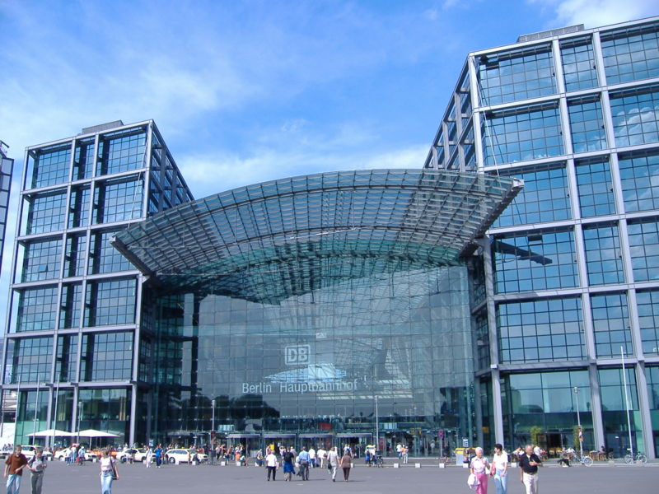
Personality Theory
https://commons.wikimedia.org/wiki/File:Berlinhbf.jpg
Notes:
Personality Theory / Moral Rights in practice
Berlin Central Station
Well-known train station, designed by a famous architect, Meinhard von Gerkan.
Took 8 years to build. Cost 700 million Euros.
The company that owns the station decided to abandon the plans for this vaulted cathedral ceiling in order to save money. They were planning to install a flat metal ceiling that was much less expensive.
Von Gerkan filed a lawsuit and claimed that the plan alterations were similar to “ripping pages out of a novel.”
The court agreed. The original design, as seen here, had to be rebuild. Cost the owner an additional 30 million Euros.

Slide 21


Moral Rights in U.S. Copyright Law?
Visual Artists Rights Act (VARA) of 1990
The only “moral rights” in U.S. copyright law
VARA exclusively grants this to visual artists:
right to claim authorship
right to prevent the use of one's name on any work the author did not create
right to prevent use of one's name on any work that has been distorted, mutilated, or modified in a way that would be prejudicial to the author's honor or reputation
right to prevent distortion, mutilation, or modification that would prejudice the author's honor or reputation

Slide 22
Fairness v. Personality
Key Differences
Basis: Fairness theory is based on rewarding effort, while personality theory is based on protecting personal expression
Rights: Fairness theory focuses on economic rights, whereas personality theory emphasizes moral rights
Geographical Influence: Fairness theory is more prevalent in common law countries, while personality theory is more influential in civil law countries

Slide 23
Questions?
Have a great week!

